Slide 1

User-Interface Design WUIV302
Lynette Barnard

Slide 2

Agenda
Conceptualising interaction
Check class list details

Slide 3
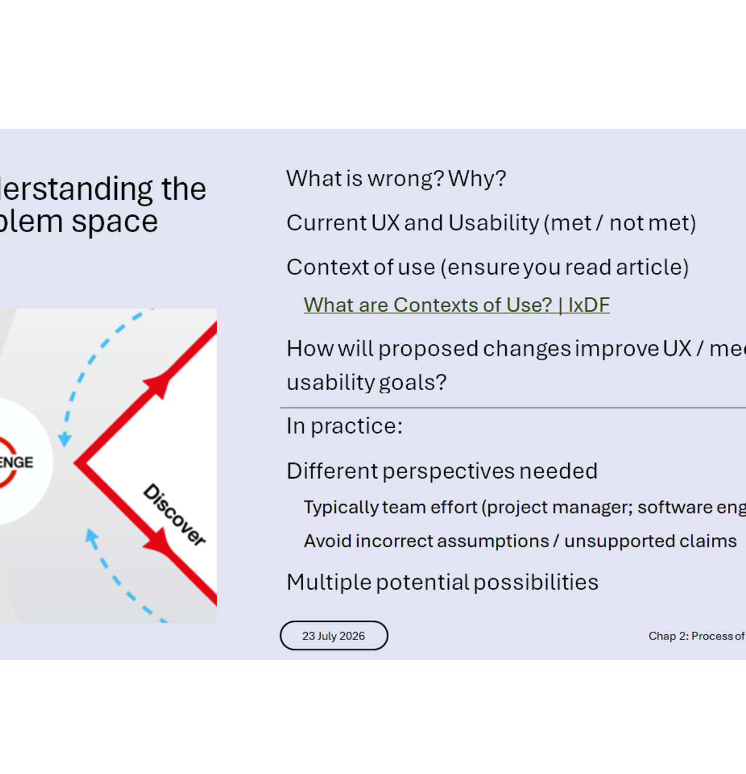
From Problem Space to Design Space
Last week → Problem Space investigated
This week → Design Space
Goes from discover phase, into define phase (answer discover questions +…)
Reality check; scrutinise for feasibility
Ideas / assumptions about benefits & UX
Assumptions and claims made
Assumption – current state
Claims – future state

Slide 4
Conceptual models
Model used in ID to articulate / describe problem and design space
Provides strategy and framework of general concepts; how these interrelate
Outlines what people can do with a product
What people need to know before using a product (what technical know-how / tech-savvy is required)
Why a conceptual model?
For designers to figure out ideas before starting designs; communicate ideas to stakeholders
Conceptual model components
Metaphors and analogies
Concepts people are exposed to when using product (e.g. organising files)
Relationship between concepts (e.g. a folder can contain many saved files)
Mapping between concepts and UX (e.g. accessible history of visited websites)

Slide 5
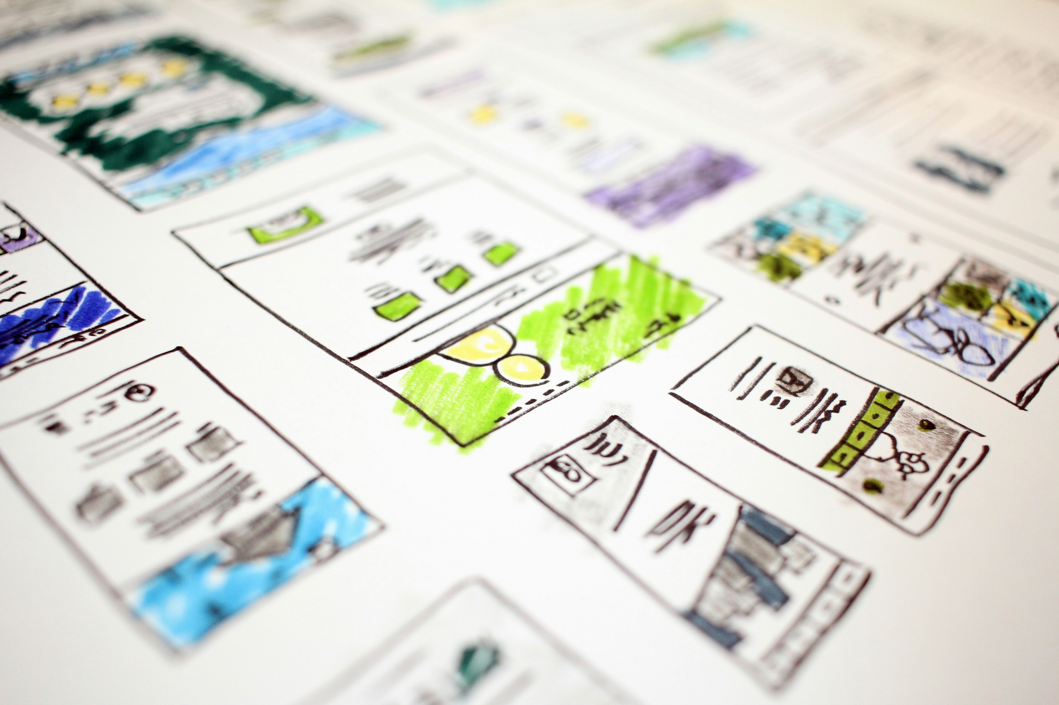
Conceptual models
Many encapsulated in design patterns
Tried and tested
No need to start from scratch
Conceptual model examples
Shopping online (place items in cart; checkout)
Online library (browse books; take out items; renew loaned items)
Digital banking (view account; check balance; pay recipient; transfer funds)
Photo by Hal Gatewood on Unsplash

Slide 6
Where do I start with a conceptual model?
Ask some questions
What will users be doing when performing tasks?
How will the system support these tasks?
What kind of interface metaphor will be most appropriate?
What interaction type(s) and interface type(s) should be used?
When making design decisions, always consider how the user will understand the underlying conceptual model

Slide 7

Link between Problem Space, Design Space & Conceptual Model
Problem space
Understand what is wrong & why
Current usability & UX
Design space
Proposed solution; expected usability & UX
Address any claims / assumptions
Conceptual model
What can users do with product
Concepts user needs to understand
Interaction and interface type
Interface metaphor (similar / familiar)
Image by jcomp on Magnific

Slide 8


Metaphors & analogies
Some metaphors part of everyday use
Imagine you are in the 1970s
Explain one of the icons to someone
You MAY NOT use the following (or similar) words: like; such as; similar to;…

Slide 9
Interaction types
Five main interaction types
Instructing
Conversing
Manipulating
Exploring
Responding
Interaction ≠ Interface
Interaction: what user does
Interface: type of interface to support interaction

Slide 10
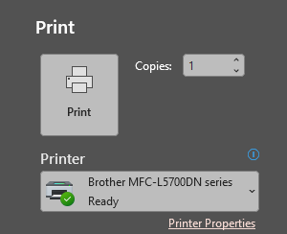
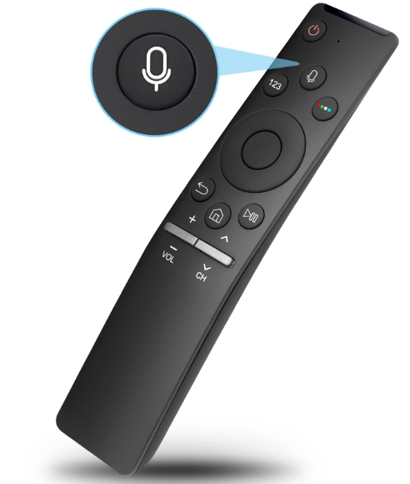
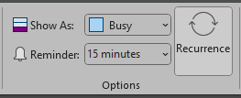
Instructing examples
Smart home voice commands

Slide 11
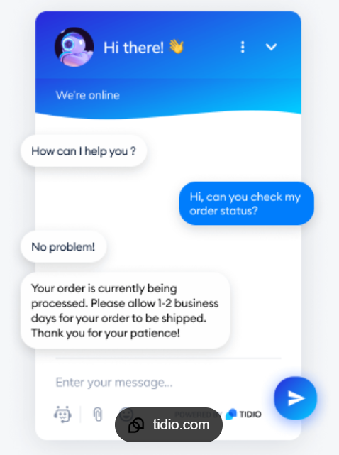
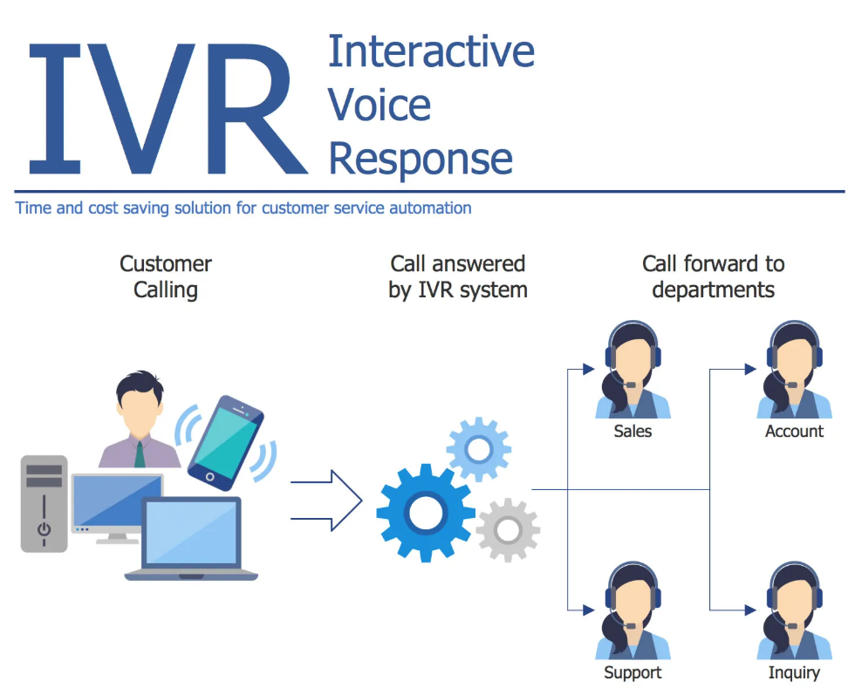
Conversing examples
Differs from instructing in that there is a 2-way communication
System acts as dialogue partner; not machine following instructions

Slide 12
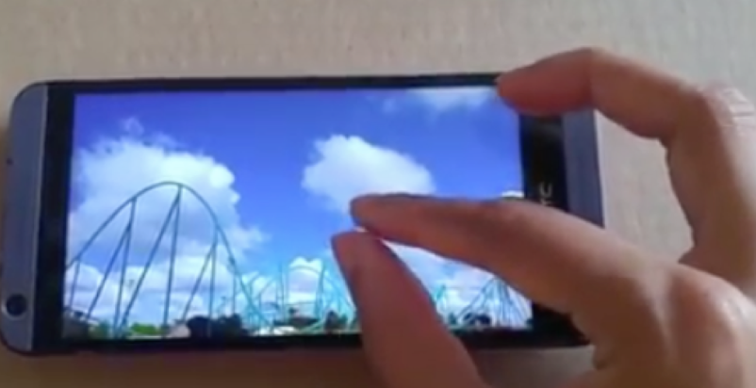

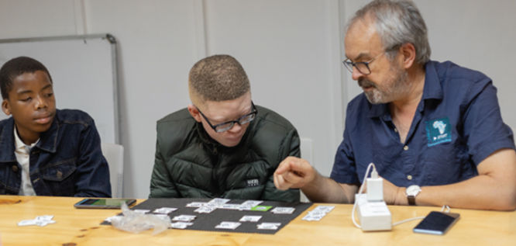
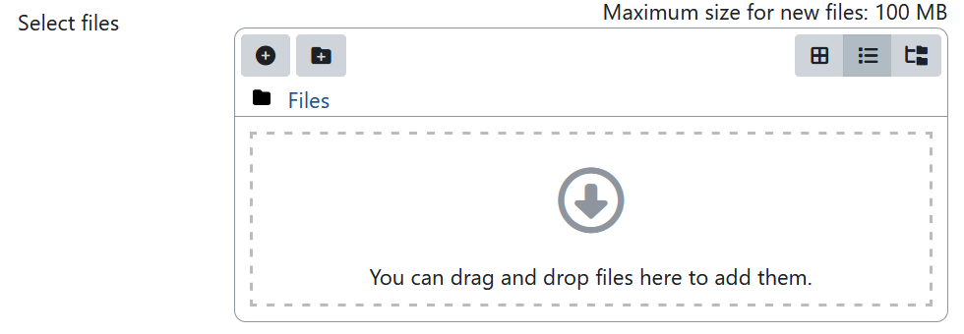
Manipulating examples

Slide 13
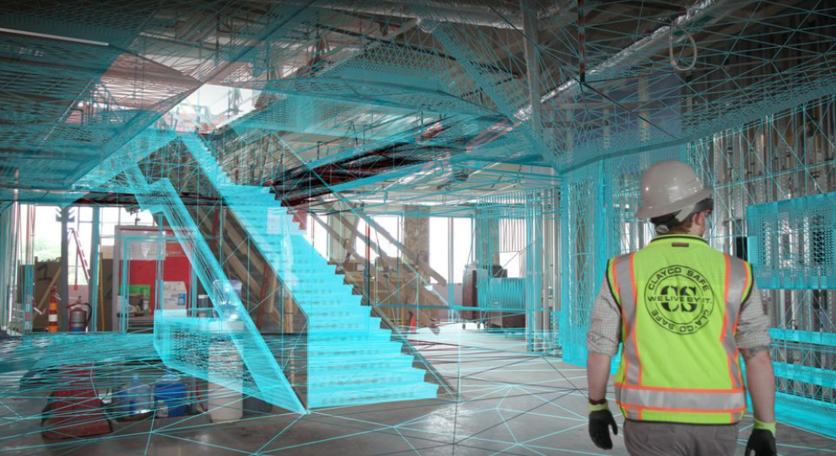
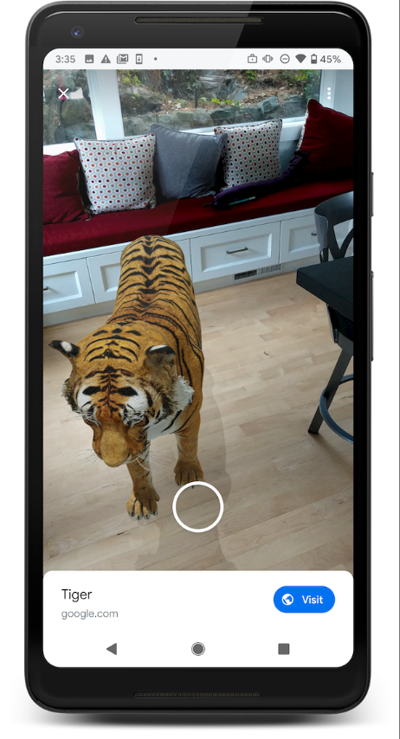
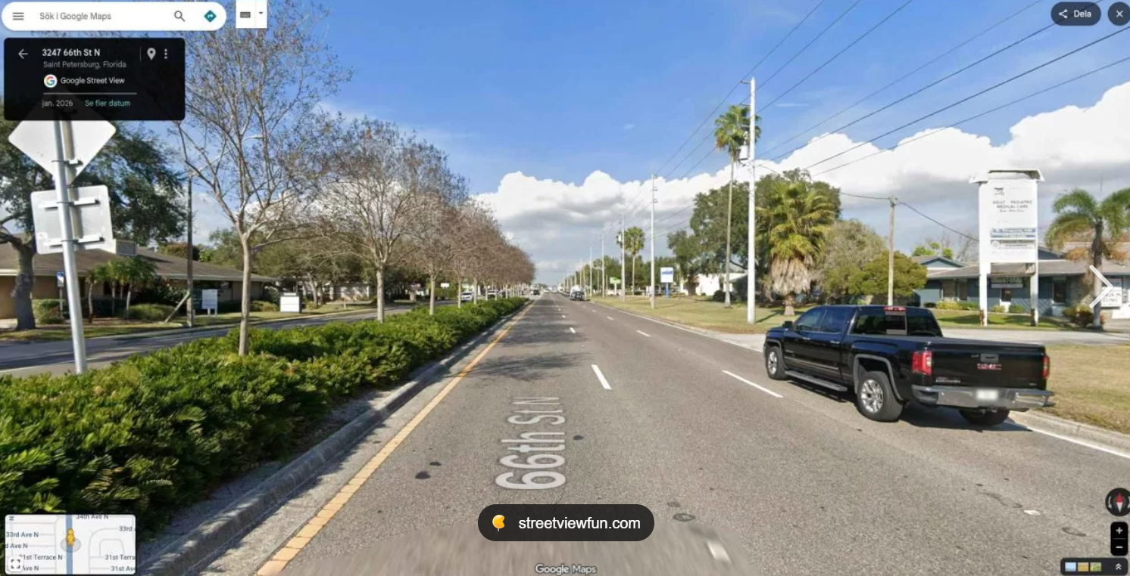
Exploring examples

Slide 14
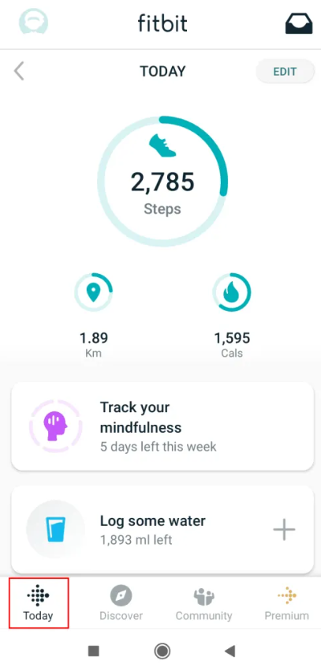

Responding examples
Engaging with an interface in response to a system-initiated engagement request
Lueg, C., Banks, B., Michalek, J., Dimsey, J. and Oswin, D. (2019), Close Encounters of the Fifth Kind: Recognizing System-Initiated Engagement as Interaction Type. Journal of the Association for Information Science and Technology, 70: 634-637. https://doi.org/10.1002/asi.24136

Slide 15
Classic HCI Framework
What typically happens
What ideally should happen
Designer’s model
User’s model
System image
Designer’s model; System image; User’s model

Slide 16
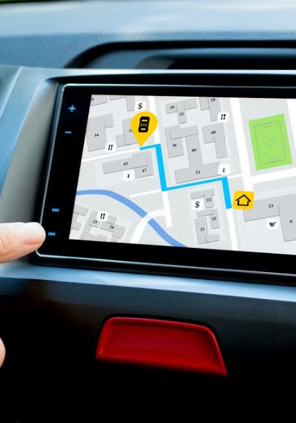
Dilemma: Who is in control?
Different interaction types vary
User control vs system control
Autonomous, context-aware systems
Environment monitors, recognises, detects deviations in behaviour
E.g. frail care environments - when behaviour is “out of the ordinary”
See Uninvited Guests by Superflux (responding interaction type)
Uninvited Guests | Videos & Movies on Vimeo

Slide 17

Discuss
How much actual control does a user have over posts appearing in their social media feeds?

Slide 18

Complete Quiz 03 2026-07-30 Conceptualising interaction 4 questions for 10 marks 8 minutes per attempt; max 2 attempts Max mark recorded
Photo by Júnior Ferreira on Unsplash

